Slide 1

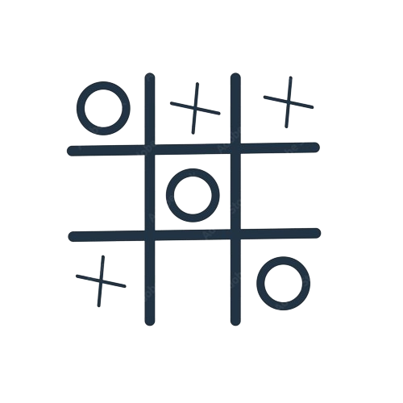
Tic Tac Toe in C
Prepared by: Manee Das Shrestha
KCE080BCT013

Slide 2
Table of contents
01
02
03
04
05
Introduction
Demonstration
Algorithm
Components
Conclusion

Slide 3
Tic Tac Toe
Tic Tac Toe is a classic paper-and-pencil game played between two players, traditionally X and O, on a 3x3 grid. The players take turns marking spaces in the grid with their respective symbols. The player who succeeds in placing three of their marks in a horizontal, vertical, or diagonal row wins the game. If the grid is filled without any player achieving a winning condition, the game is a draw.
INTRODUCTION

Slide 4
Algorithm:
Steps:
Start
Choose mode for playing. PvP or PvC
In case of PvP, Enter both players name, start game.
In case of PvC, game starts instantly, with computer taking the first turn with symbol O.
The computer plays with the logic of minimax algorithm with alpha beta pruning.
Players play alternately with their respective symbols.
If there’s a winning condition, the respective player wins.
If the board is completely filled without any winning condition, its a draw.
Print the relevant information in the text document for logging purposes.
End

Slide 5
Minimax Algorithm:
Minimax examines all possible moves that both players (X and O) can make on the board.
It evaluates each possible resulting game state to determine if it leads to a win, loss, or draw for the current player (X or O).
Based on these evaluations, it assigns a score to each possible move.
If it's X's turn, Minimax selects the move with the highest score (indicating the most advantageous move for X), assuming O plays optimally.
If it's O's turn, Minimax selects the move with the lowest score (indicating the most disadvantageous move for O), assuming X plays optimally.
This process continues recursively until it reaches a terminal game state (win, loss, or draw).
By considering all possible moves and their outcomes, Minimax ensures that the player makes the best move possible at each turn, aiming to either win the game or force a draw if winning isn't possible.

Slide 6
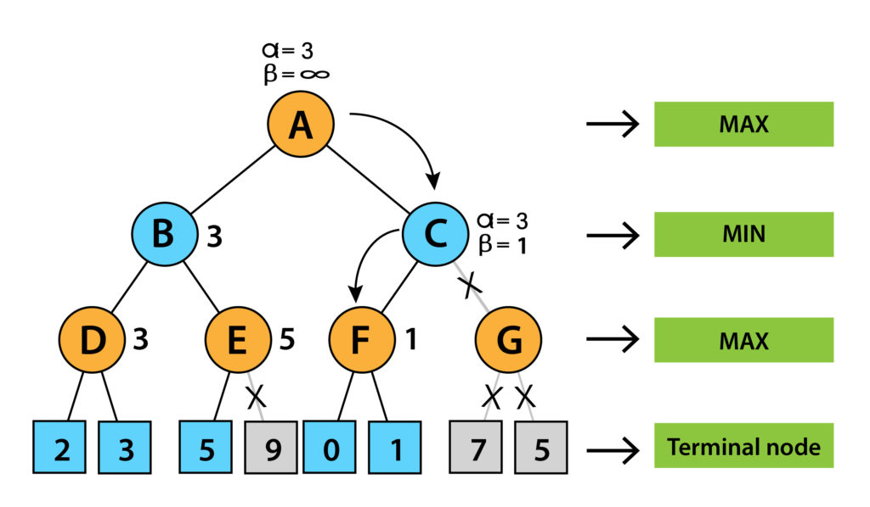

Slide 7
Components:
Header Files Used
Global Variables
#include <stdio.h>
#include <stdlib.h>
#include <time.h>
#include <conio.h>
#define SIZE 3
#define X -1
#define O 1
#define EMPTY 0
FILE *fp=fopen("tic-tac-toe-log.txt","a");
int board1[SIZE][SIZE]; //board for PvC
char board2[SIZE][SIZE]; //board for PvP

Slide 8
Components:
initializeBoardPvC( )
initializeBoardPvP( )
showBoard1( )
showBoard2( )
printBoard1( )
printBoard2( )
checkWinner( )
isWin( )
evaluateBoard( )
minimax( )
findBestMove( )
userMove( )
playerVsComputer_Hard( )
playerVsComputer_Easy( )
computerMove();
playerVsComputer( )
playerVsPlayer( )
User Defined Functions:

Slide 9
Demonstration:

Slide 10
Conclusion:
Hence, Tic Tac Toe project was created in C using several of its core concepts which include, matrix manipulation, file handling, user defined functions along with the game theory of minimax algorithm.

Slide 11


